Slide 1
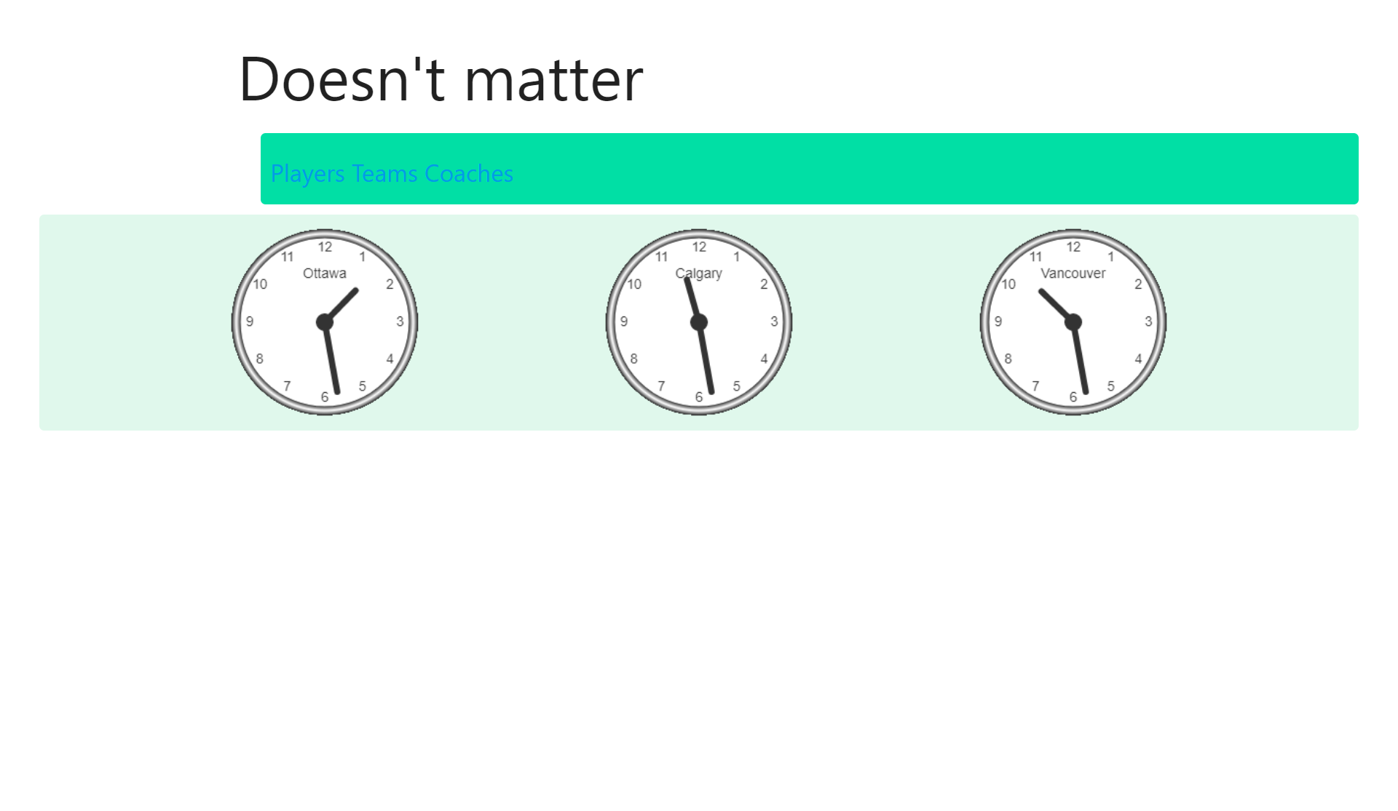
User Manual
Links that open the tables
Clocks show real-life time from
Three Canadian cities: Ottawa, Calgary, Vancouver
This is how the page looks like when it first loads

Slide 2
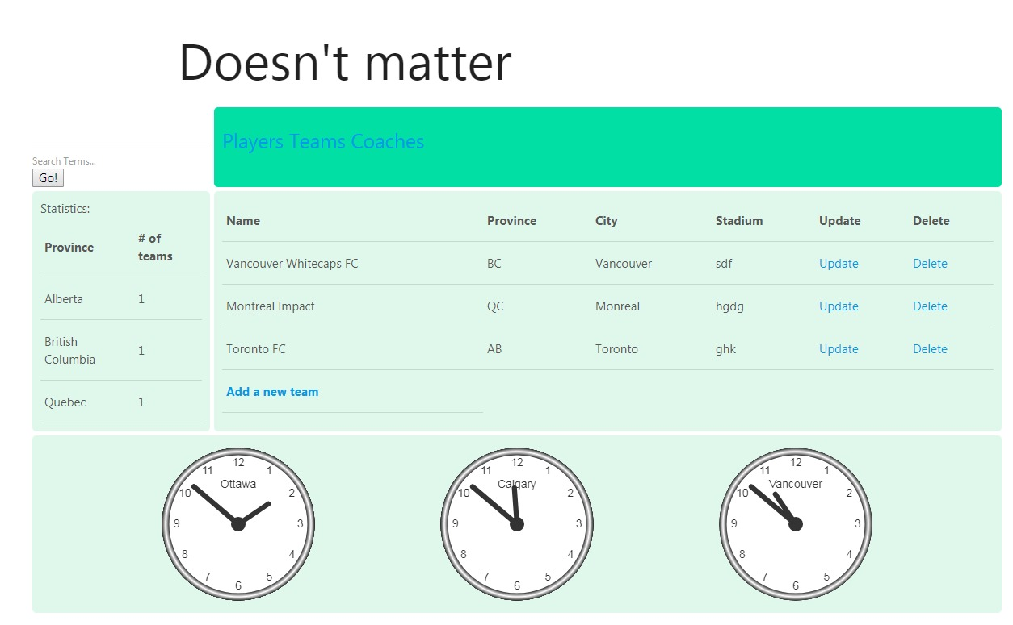
The page after clicking the “Teams” link
Links to manipulate the data
Statistics for the table

Slide 3
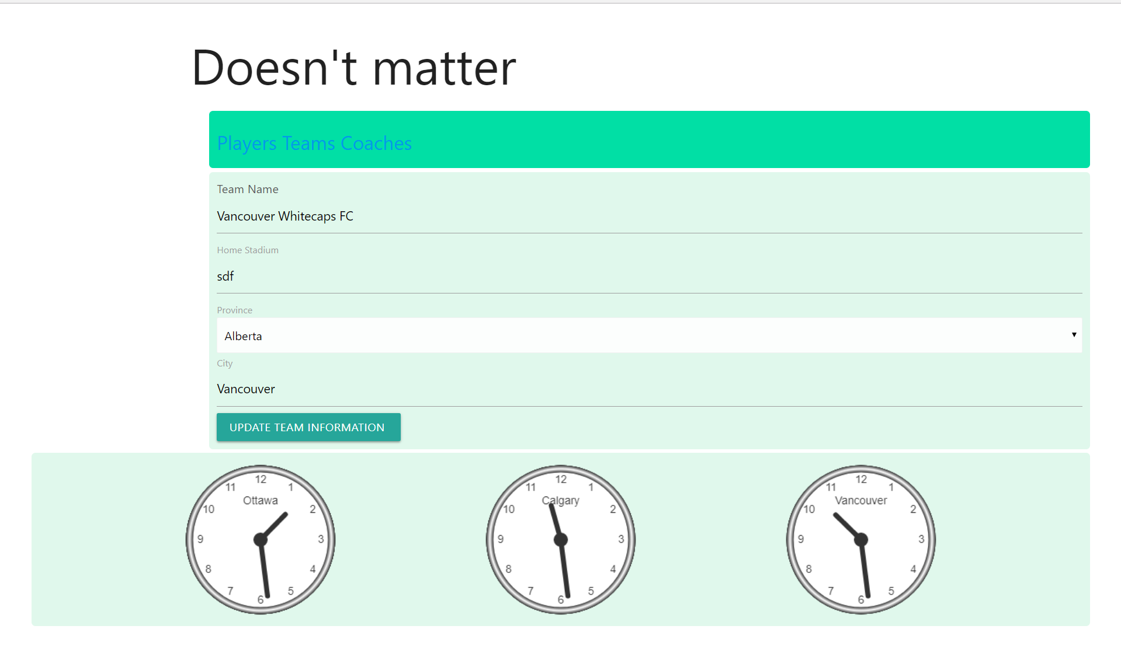
Update form after clicking an “Update” link

Slide 4
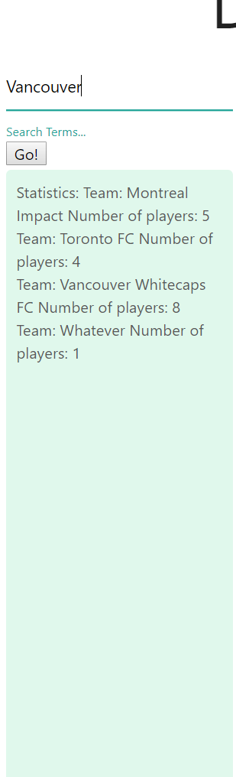
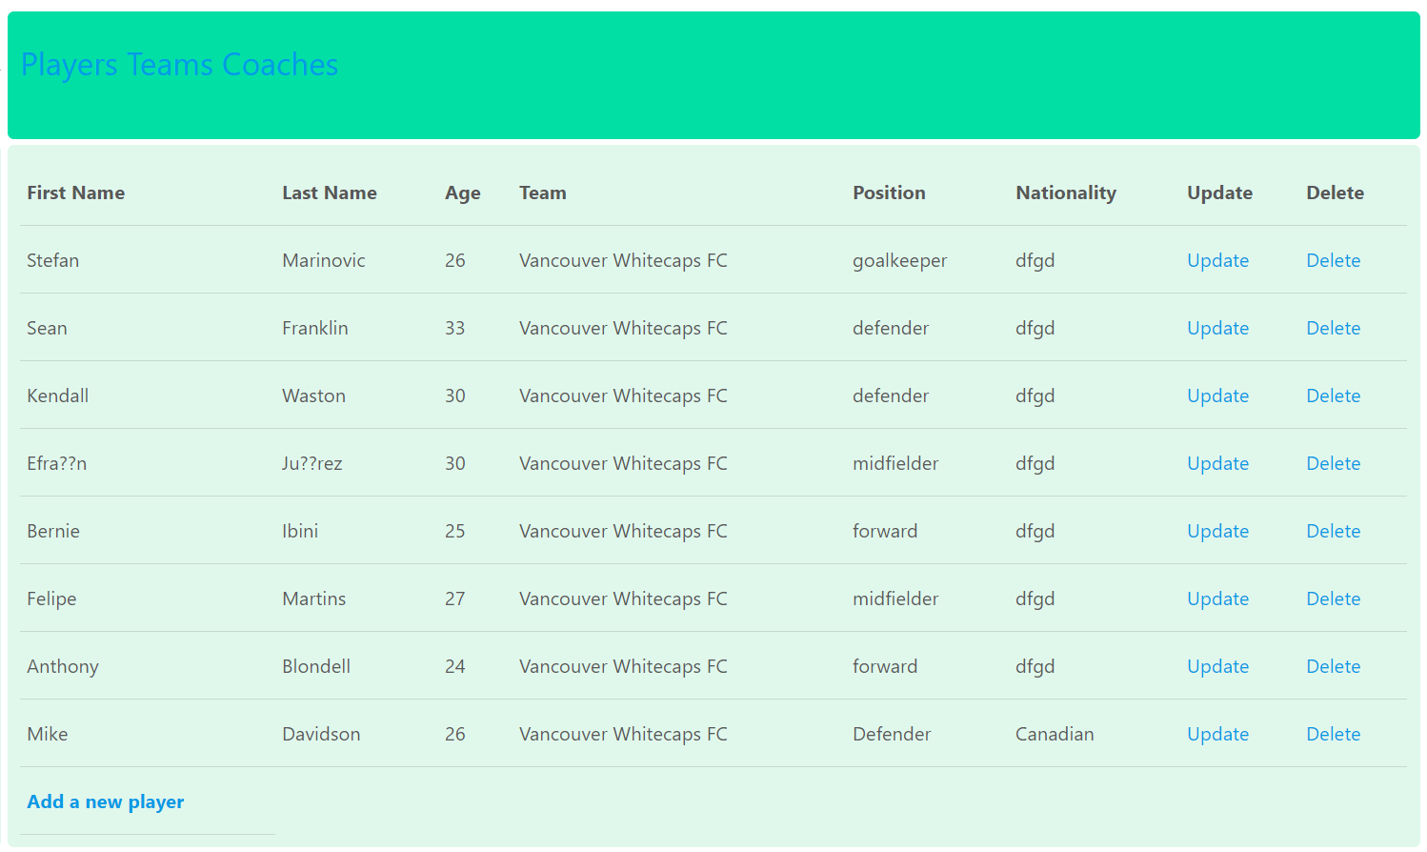
Search form that searches through the table
Table after the search for “Vancouver”

